Slide 1
Final Project
Team Amber
Dan Seiler, Elenaor Brooks, Jada Hunter-Hays, Thomas Bioren

Slide 2
Table of Contents
Overall Architecture
Core Instruction Set
Instruction Types
Multicycle RTL
Final Datapath
Approach to Unit Testing
Implementation of Testing
Important Design Decisions
Snippets of Assembly Code
Unique Design Aspects
Biggest Challenges
Good Aspects of the Project
Things we wish we implemented

Slide 3
Accumulator Architecture
Wanted to prioritize simplicity
Minimal # of instructions and instruction types(2) in our core set and 4 designated registers
We have one general purpose register(“reggie”), and three special purpose registers reserved for input(“in”), output(“out”), and a status register(“sr”)

Slide 4
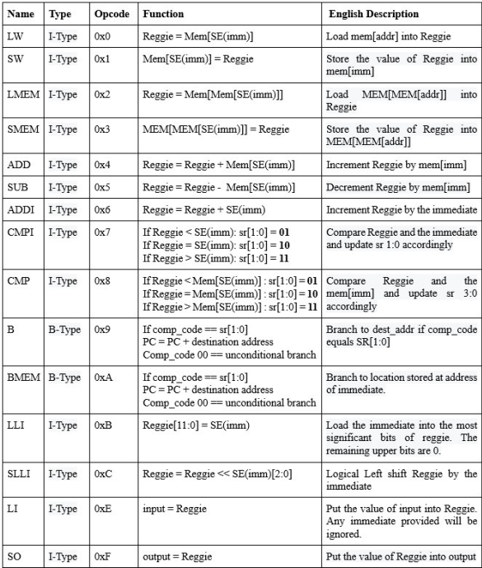
Core Instruction Set

Slide 5
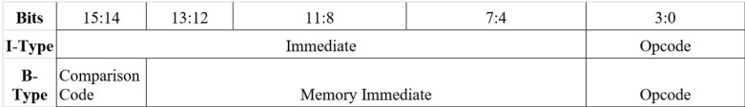
Instruction Types

Slide 6
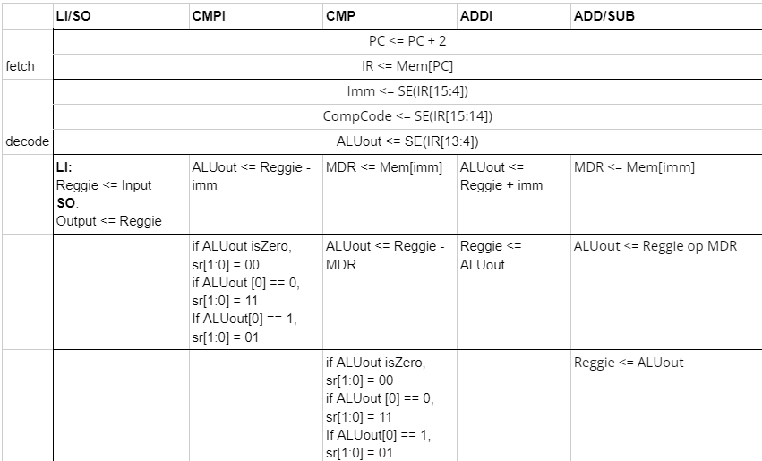
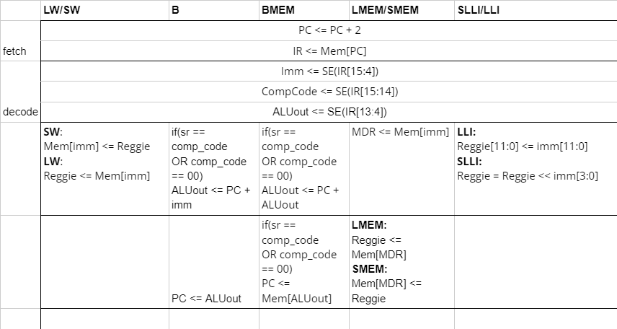
Multicycle RTL

Slide 7
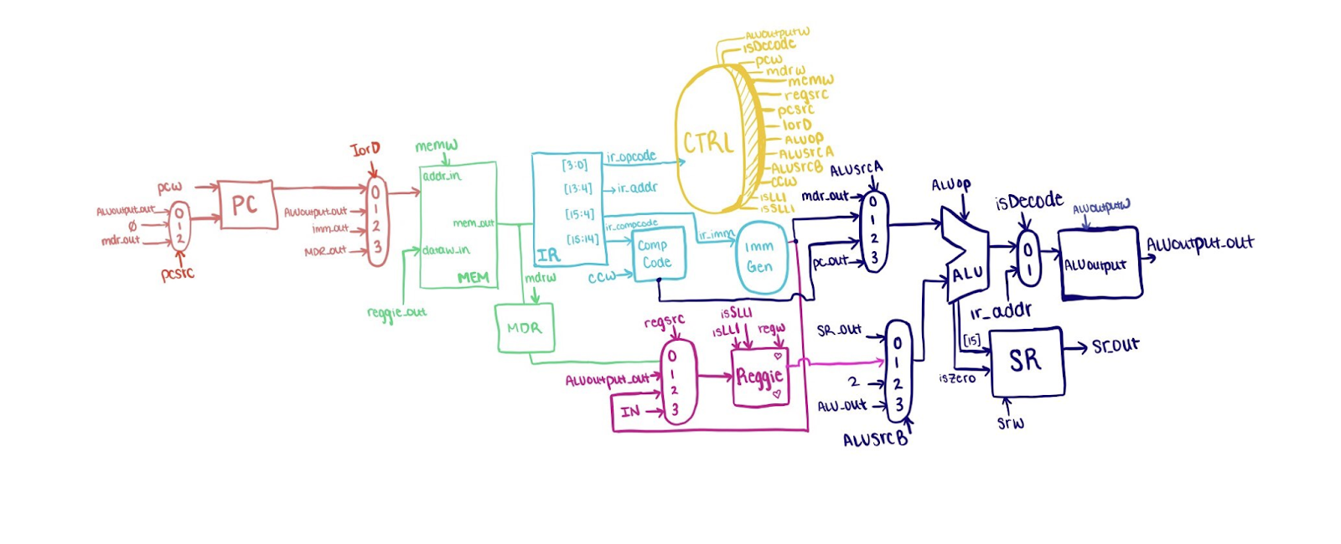
Final MultiCycle DataPath

Slide 8







Approach to Unit Testing

Slide 9
Implementation of Testing Components
Memory, MDR Register
RegOp Mux, Reggie
Stage1
Stage2
Stage3
Stage4
Stage5
PC Register, IordMux
IR Register, Compcode Register, Immediate Generator
alusrcA mux, aluscrB mux, ALU, and ALU_output register, SR register
Our integration plan consisted of us implementing 5 subsections, stages, shown in the previous diagram.
In each stage we incrementally implemented all of the components in each stage together and then tested all of the stages together into the full Datapath. Then tested that the individual instructions are running and occurring when they are supposed to work.

Slide 10
Important Design Decisions
Minimizing the amount of instruction types to 2 instead of 3
Making the Datapath Multicycle and not pipelining
Decided that the addressing will be pc relative but changed it back to return addressing
Added a second fetch cycle
Added another cycle for memory cycle and stopped using MDR
Changed PC Write to account for branching(common multicycle issue discussed in class)
Memory Mapping was changed

Slide 11
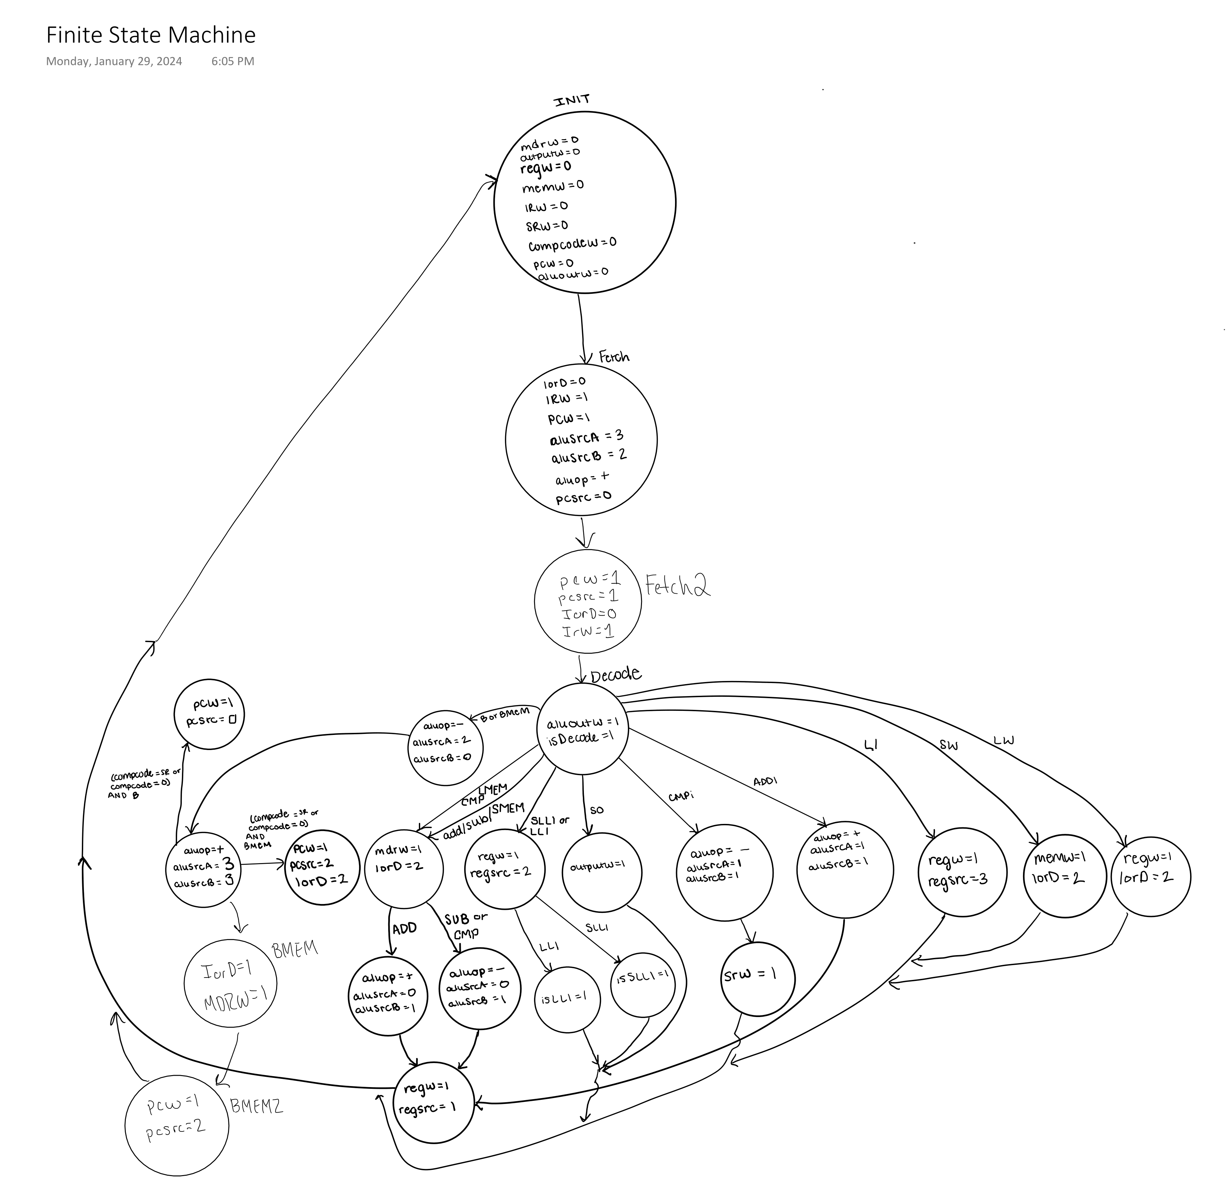
Finite State Machine

Slide 12
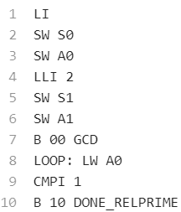
Assembly Code Snippet

Slide 13
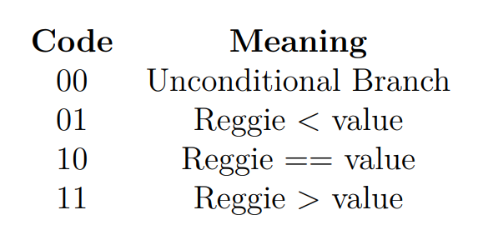
Unique Design Aspects
Status Register
Assembler
Wanted to implement conditionals with limited instruction set efficiently
SR is a 2-bit register that holds comparison codes
If comparison codes match the program branches otherwise the processor does not branch
This was a key extra feature
Made for efficient debugging of our project code
Manually assembles the program every time you make an edit.
Written in python3

Slide 14
Biggest Challenges
Elenaor’s Modelsim does not work, could not be fixed by professors nor EIT
Two student athletes, a theatre group, ROTC student so busy schedules for meeting
Did not stick with original integration plan so faced a lot more debugging than we might have had to deal with.
Missing fundamental hardware/ctrl bits
Transparency with deadlines

Slide 15
Good Aspects of the Project
Assembler
Design Document Organization
Frequent use of Team Groupchat
Task Manager to delegate tasks for integration
Use Verilog Documentation from Labs
While we struggled with communication in the beginning towards the end we have gotten much better as a group
Rigorous Testing of Stages

Slide 16
Things we wished we did
Implemented the Subleq Code Shown in Class
Tested each of our instructions more rigorously earlier on

Slide 17
Thank you
-We would like to extend thanks to
-Dr. Williamson
-Rose-Hulman’s CSSE Department
-Teammates even with our busy schedules
- Friends we made along the way

